Slide 1

Modern House: A Comprehensive Service Platform
Team Members: Durgesh Kumar Tiwari, Anubhav Soni, Vipin Sharma

Slide 2

.TECHNOLOGIES USED.
Front-End
Back-End
HTML (Hypertext Markup Language)
Flask (Python)
It​ defines elements like headings, paragraphs, forms, buttons, and other essential components of the web pages.
Modern House’ s backend is built using Flask, a lightweight and flexible web framework in Python. Flask is known for its simplicity and ease of use, making it ideal for building web applications quickly.
CSS (Cascading Style Sheets)
It controls layout, visual styling, and user experience of websites and web applications effectively.
MySQL
It is an open-source relational database management system that organizes and manages data efficiently and effectively.
JavaScript
It is a high-level, dynamic, and interpreted programming language for web development, and mobile applications.

Slide 3

Why Modern House?
Comprehensive Services
A Unique Experience of Living
Modern House focuses on simplifying cross-border transactions by integrating multilingual support, currency conversion, and international payment systems, which many platforms struggle to implement seamlessly.
While platforms like Airbnb focus solely on property rentals, Modern House integrates multiple household and property services in one place, creating a more holistic and convenient experience for users.
Transparent Pricing
Our platform emphasizes clear, itemized pricing for property bookings and additional services, eliminating hidden costs and providing better budgeting flexibility.

Slide 4
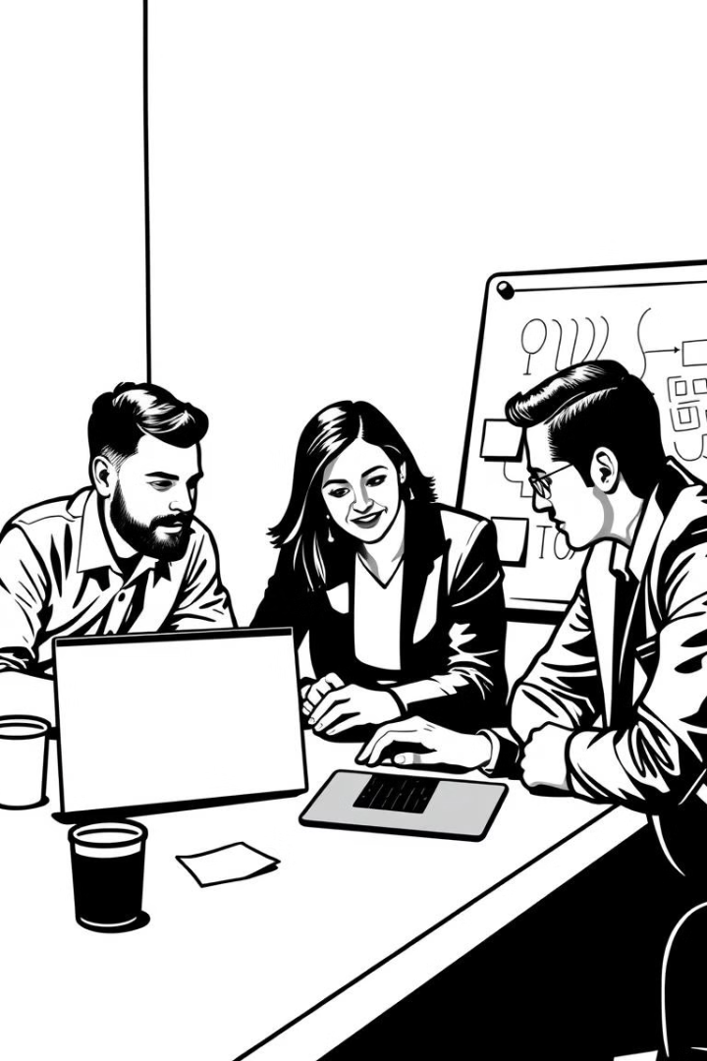
Role of Members
Name
Role
Key Responsibilities
Durgesh Kumar Tiwari
Front-End Developer
User interface design, development, and optimization.
Vipin Sharma
Project Manager
Project planning, execution, Project Documentation, and team management.
Anubhav Soni
Back-End Developer
Server-side logic, API development, database management, and security.

Slide 5

Vipin Sharma (Project Management)
Documentation
Planning
I took the lead in documenting the project and managing all expects related to its planning , execution and quality assurance, ensuring seamless coordination and successful delivery of the project.
I defined project scope, timelines, and deliverables to ensure efficient execution and timely completion.
1
2
3
4
Execution
Team Management
I overseed the implementation of tasks, monitoring progress and ensuring that the team adheres to established plans and methodologies.
I fostered a collaborative and productive environment, motivating the team, and providing guidance and support.

Slide 6

Durgesh Kumar Tiwari (Front-End Developer)
1
HTML, CSS, JavaScript
2
UI/UX Best Practices
I prioritized creating a seamless and intuitive user experience by implementing UI/UX best practices, ensuring user engagement and satisfaction.
I used these fundamental technologies to create the user interface of the Modern House website, ensuring its visual appeal and functionality.
3
Collaboration
I collaborated with the design team to ensure the website's aesthetics align with the overall brand identity.

Slide 7

Durgesh Kumar Tiwari (Front-End Developer) Soft Skills
1
Analytical Thinking
2
Debugging Skills
3
Collaboration
I applied analytical thinking to design efficient algorithms and data structures, optimizing the platform's performance and responsiveness.
I possessed strong debugging skills, allowing him to identify and resolve complex issues quickly and efficiently.
Collaboration with the design team for aesthetic alignment Problem-solving for ensuring a bug-free and smooth user experience.

Slide 8





Anubhav Soni (Back-End Developer)
Server-Side Logic
I developed and maintained server-side applications, handling user requests and data processing.
API Development
I builded APIs to connect the front-end and back-end, enabling seamless data exchange and integration with third-party services.
Database Management
I managed the MySQL database, ensuring efficient data storage, retrieval, and security.
Scalability
I worked on building scalable solutions to accommodate increasing traffic and user demands, ensuring the platform's stability.

Slide 9





Anubhav Soni (Back-End Developer) Technical Skills
Programming Languages
Database
I am proficient in Python and Java, utilizing these languages for developing efficient and scalable back-end applications.
I have expertise in MySQL, a robust and scalable database management system used for storing and managing data efficiently.
API Integration
Server Management
I exceled at integrating APIs, allowing the application to interact with various third-party services, such as payment gateways and mapping services.
I possessed strong server management skills, ensuring the platform's availability and performance by configuring and maintaining servers.

Slide 10

Modern House: A Platform for the Future
Modern House is not just a service platform, it's a vision of a future where convenience and accessibility meet quality and trust. It has the potential to revolutionize the property rental industry by offering an all-in-one solution that combines property booking with personalized, transparent services. With global reach, scalable technology, and AI-driven personalization, the platform caters to the growing demand for seamless, trustworthy experiences among digital nomads, travelers, and expatriates.

Slide 11
Thank You
We appreciate your time and interest in Modern House. We are confident that our platform can revolutionize how you manage your daily life.

